Slide 1
Predicting Employee Attrition
By: Aaron Camacho

Slide 2

About Me
Data Scientist, MBA
10+ Years of Experience
Banking
Financial Services
Data Analysis
Statistics

Slide 3
Problem Statement
The cost of losing an employee can range from tens of thousands of dollars to 1.5 – 2.0x the employee’s annual salary (Altman, 2017).
What are the most likely reasons for an employee to leave a company and can the turnover possibility be predicted before it happens?

Slide 4

Hypothesis
If an employee has more tenure with the company, he/she is less likely to leave.

Slide 5
Data Analysis Summary
Logistic regression was used due to its ability to handle both categorical and numeric variables. However, other standard models were compared to discover the best approach (i.e. decision tree, random forest, CART, etc.).
35 variables analyzed 22 variables used in predictive model

Slide 6
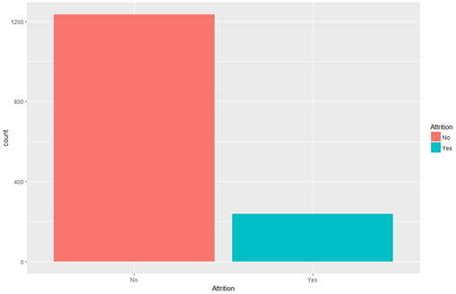
Attrition
Attrition:
Yes = 16.12 %
237 Employees left
No = 83.88%
1,233 Employees stayed

Slide 7
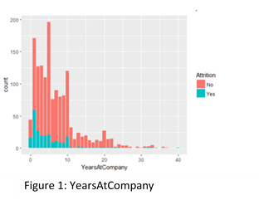
Years at Company
Variable “YearsAtCompany”, it was found that employees with more tenure were in fact less likely to leave.

Slide 8
Unique Variable Creation
Average Tenure per Job = TotalWorkingYears/NumCompaniesWorked.
Years without Promotion in Current Role = YearsInCurrentRole – YearsSinceLastPromotion.
Years without Promotion with Current Manager: YearsWithCurrentManager – YearsSinceLastPromotion.
Notes:
. New variables were created based off of conventions of the given variables.
Average Tenure per Job = TotalWorkingYears/NumCompaniesWroked. For this group the assumption was made that certain individuals are motivated by change. These individuals work for a company for a few years but end moving to a new company within a few years. We will see that those with a lower average tenure per a job are more apt to leave.
Years without Promotion in Current Role = YearsInCurrentRole – YearsSinceLastPromotion. The assumption here that was made here was employees that are seeking growth through a promotion are more likely to leave if a promotion is not gained within a reasonable amount of time. It is important to note that it is unclear whether the current role was a promotion or not.
Years without Promotion with Current Manager: YearsWithCurrentManager – YearsSinceLastPromotion. Like the variable above, the assumption made here was that employees that are seeking growth through a promotion are more likely to leave if a promotion is not gained within a reasonable amount of time. However, it focuses on time with a manager vs current time in a role. It is important to note that it is possible that an employee might have a new manager but has not received a promotion which would cause a negative value.

Slide 9
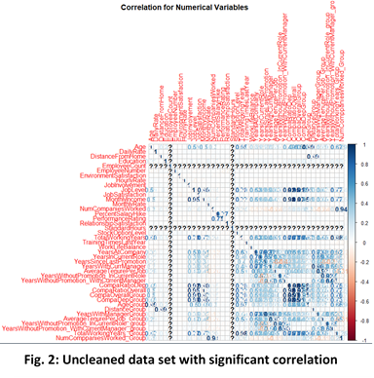
Variable Correlation Check
Highly correlated variables, approaching +/- 1, and variables that have a near zero variance which is represented with a “?”.
Variables that are <> 0.60/-0.60, were considered highly correlated and were removed

Slide 10
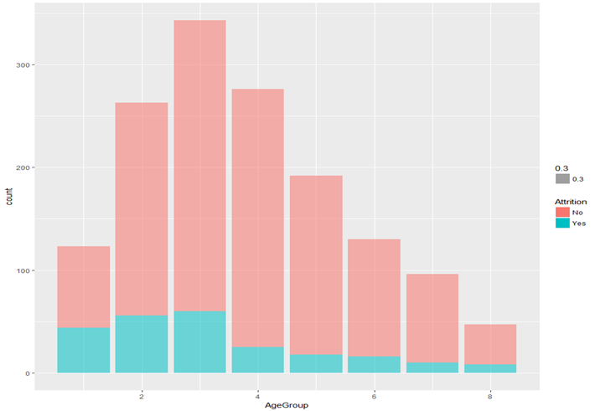
Binning
Age Group:
1 = 25 or less years
2 = 26 to 30
3 = 31 to 35
4 = 36 to 40
5 = 41 to 45
6 = 46 to 50
7 = 51 to 55
8 = 56 or greater

Slide 11
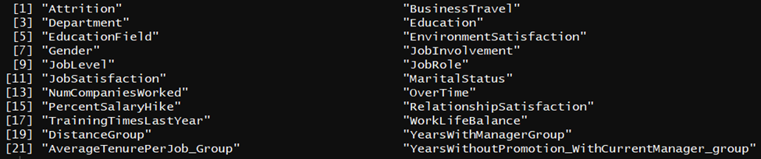
Prediction Model Variables

Slide 12
Tools & Techniques
Hierarchal Clustering K – Modes
Comparative model testing
Logistic Regression
Decision Tree
Discriminate Analysis: Chi-Squared & ROC Curve
Variable Importance

Slide 13
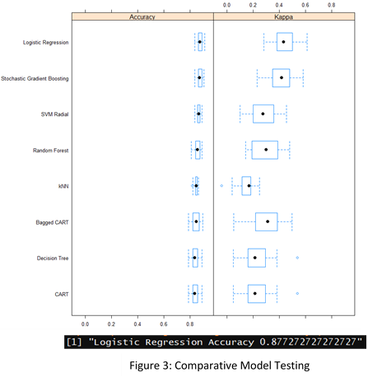
Comparative model testing

Slide 14
Logistic Regression
Prediction Accuracy 87.73 % at 95 percent confidence level
7 Most Significate Variables Identified
Notes:
“Business Travel, Environmental Satisfaction, Job Involvement, Marital Status, Num of Companies Worked, Overtime, Years Without Promotion With Current Manager group”
A deviance table shows that as you add a variable there is a reduction in the deviance residual. However, some variables have a greater impact on reduction of deviance residual than others. The variables “OverTime”, “JobLevel”, “YearsWithoutPromotion_WithCurrentManager _group” and “BusinessTravel” have some of the greatest deviance residual reduction impact and each have low p-values, or p-values less than 0.05, signifying a significant influence on attrition. On the other hand, the variables “Education”, “YearsWithManagerGroup”, “AverageTenurePer job_group”, and “TotalWorkingYears_Group” have larger p-values and have a much smaller impact on the Figure 5: Deviance Table
reduction of the residual deviance

Slide 15
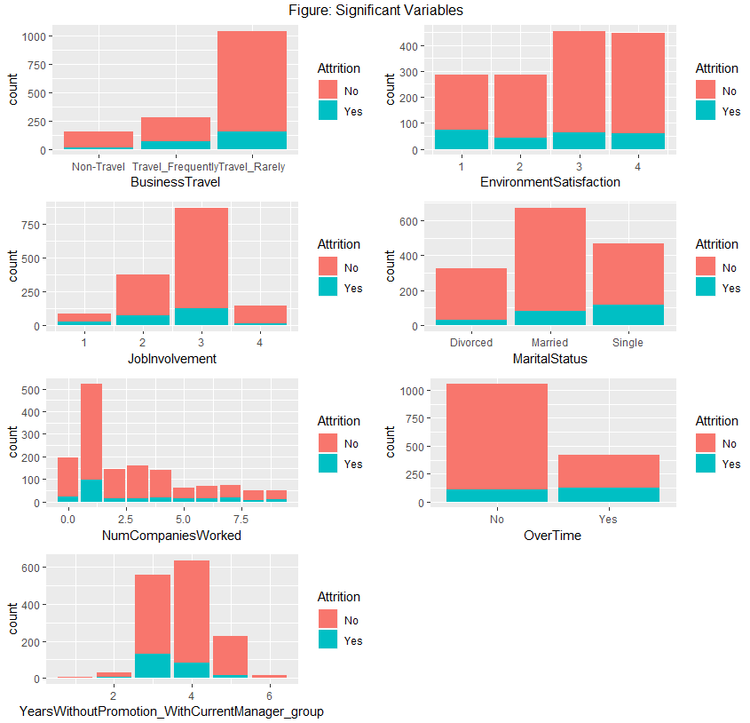
Findings
Most Significant Variables
OverTime
BusinessTravel
EnvironmentSatisfaction
JobInvolvement
MaritalStatus
NumCompaniesWorked
YearsWithoutPromotion_WithCurrentManager_group.

Slide 16
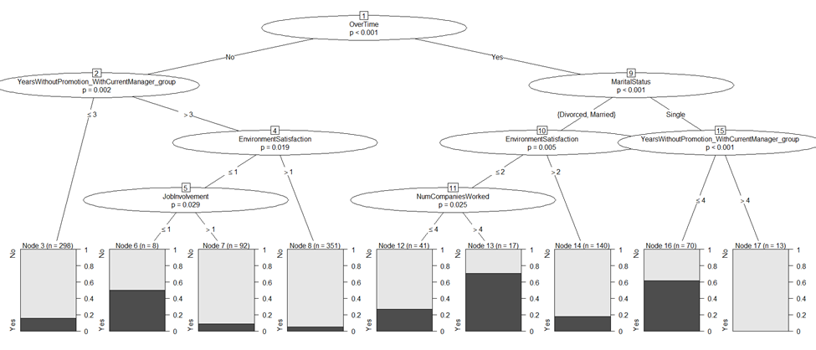
Decision Tree
Notes:
Of the seven variables, the most significant is Overtime. Meaning the variable Overtime and whether or not an employee has overtime is the best variable to indicate whether or not an employee will leave. Four other things we can pull from the decision tree are (1) Employees that are single and in group 4 or less (have 5 years or less) without a promotion with their current manager are more likely to leave. (2) If an employee has worked for more than four companies he/she is more like to leave than if they have worked for four or less companies. (3) If an employee has a job involvement level less than or equal to one he/she is more likely to leave. (4) Environmental Satisfaction seems to have and influence on whether an employee will leave a company especially if their environmental satisfaction level is less than or equal to one.

Slide 17
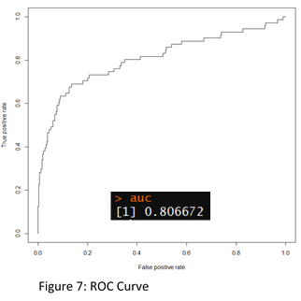
Discriminate Analysis
Chi-Squared
critical value was lager than the residual deviance. Good Model Fit
ROC Curve
model is 0.80 or greater. Model is Discriminate.
Notes:
logistic regression model and the Chi-Squared calculation that the critical value at 95 percent confidence and 992 degrees of freedom is 1,066.385. Since the residual deviance of 575.87 is less than the critical value the null model is not rejected.
As for the ROC curve,
Figure 7: ROC Curve
the area under the curve was calculated. A possible area value under the curve is between 0.50 and 1.00. If the curve for the selected model is 0.80 or greater, it can be determined that the model is discriminate. The calculated area under the curve for the logistic regression model was 0.806672. The logistic regression model was found to be discriminate.

Slide 18
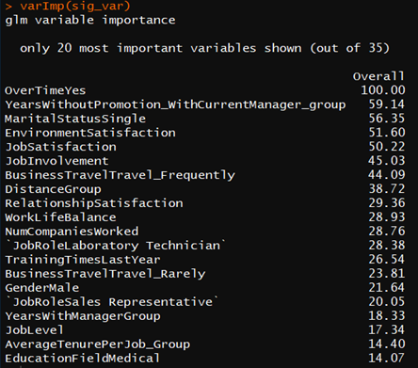
Variable importance
Overtime has a 40 percent greater impact on Attrition that the next most significant variable.

Slide 19
Proposed Actions
1. Overtime: Identify the reasons for overtime and attempt to reduce if not eliminate the need for employees to work excessive hours.
2. Promotion: Identify employees that have not received a promotion within the three to ten years.
* Limitation: Predicting Human Emotion
Notes:
To overcome this limitation, I purpose two approaches to further study the data set. First, surveys can be sent out to employees that have previously left the company. The surveys could ask for further information and understanding on the reasons they left. Questions could include but are not limited to the following: Did you feel valued at work? If there was another position that interested you at (company name) would you return? Why or why not? Out of a scale from 1 to 10, one being unsatisfactory and ten being Outstandingly satisfactory, rate your experience with (company name). Out of on a scale of 1 through 5 rate your satisfaction with your manager. etc. There are many options for questions but they should seek to gain further understanding. Also, though selective answer questions are good, open-ended questions should also be used to give a chance for the former employee to express their options without being confined to a predetermined set of answers.
The second approach as mentioned previously, HR should use the analysis to direct decisions. The purpose of the analysis is not to make decisions but to help in the guiding of decisions. Furthermore, the HR department should focus on a follow-up survey for current employees that focuses on deepening the understanding of the analysis. The goal being that it would shine a light on policies and procedures that could be changed to better the workplace experience and environment.

Slide 20
Benefits
Reduced attrition/turnover of employees
Increased revenue
Increased job satisfaction
Bonus: When you take the steps to improve working conditions and invest in employee support and satisfaction you will have happier workers and a greater potential for a return on your investment.
Notes:
1. reduced attrition/turnover of employees. In the beginning of this summary we surmised that the cost of attrition could be 1.5 to 2.0 times an employee’s annual salary (Altman, 2017).
2. It takes up to 2 years for an employee to become fully productive (Marsden-Huggins, 2017)
3. “A recent study by economists at the University of Warwick found that happiness led to a 12% spike in productivity, while unhappy workers proved 10% less productive. As the research team put it, “We find that human happiness has large and positive causal effects on productivity. Positive emotions appear to invigorate human beings. (Revesencio, 2015)” The key to more positive employees is to invest in employee support and satisfaction.
Bonus Point: Though it would be hard if not impossible to calculate a specific percentage increase or decrease within these three benefits that could be applied to each company there is one thing that we can be sure of, when you take the steps to improve working conditions and invest in employee support and satisfaction you will have happier workers and a greater potential for a return on your investment.

